Slide 1
Research and Improvements on PageRank Sort Algorithms
Group - 16
JayaChandra Battula
Rahul Ram Grandhi
Ravi Yadav

Slide 2
Overview
Introduction.
Background.
HITS Algorithm.
Pagerank Algorithm.
Improvements of pagerank sort algorithm.
Results.
Conclusion.

Slide 3
Introduction
Millions of electronic pages added every day.
Difficult to find the desired information of resources.
Web mining using information retrieval.
More effective methods are needed to help users manage the retrieval results.

Slide 4
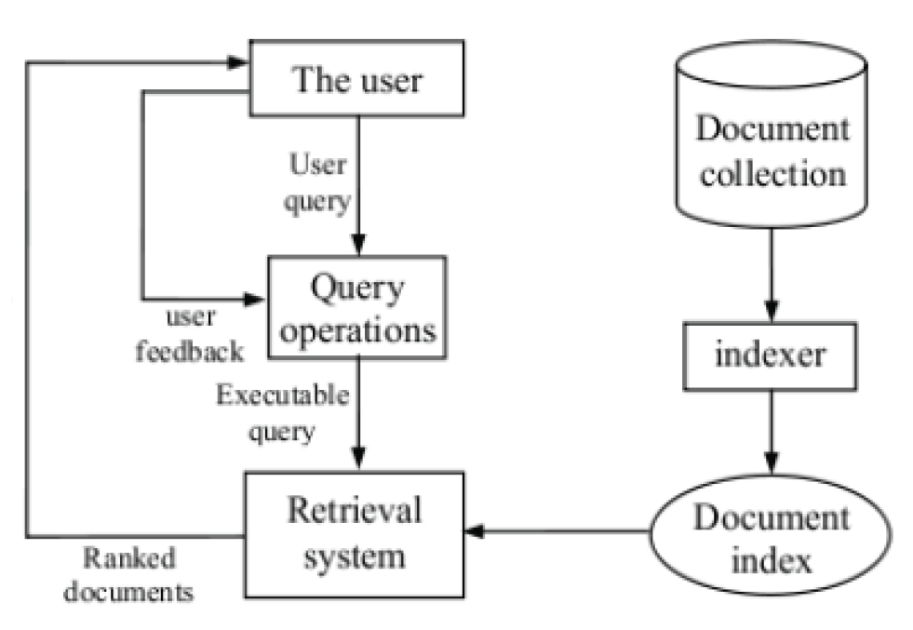
Background
3 Phases in retrieval systems
Based on word frequency.
Based on link analysis.
Based on intelligent retrieval.

Slide 5
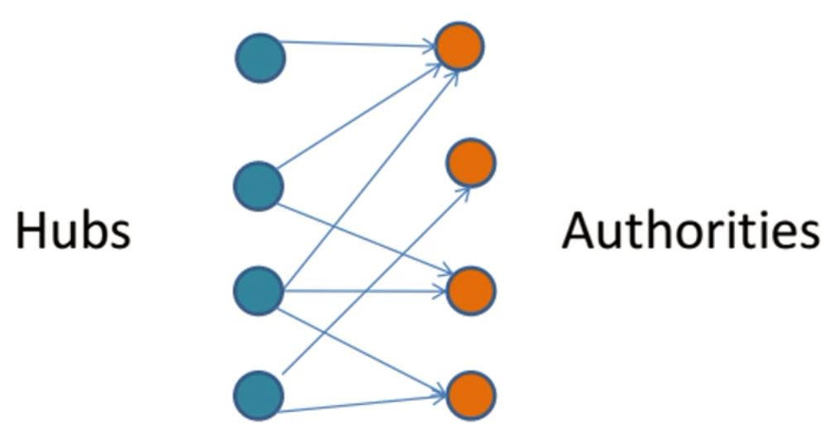
HITS Algorithm - (Hyperlink-Induced Topic Search)
Developed by Jon Kleinberg in 1998.
Hubs and Authorities.
Base graph is obtained from search results.
Importance of page is calculated based on
the hub and authority score.
Notes:
HITS algorithm is a link analysis method proposed by Dr. Kleinberg in 1998.
It is part of “CLEVER” research project of IBM Almaden Research Center.
A good hub represents a page that points to many other pages.
A good authority represents a page that was linked by many different hubs.

Slide 6
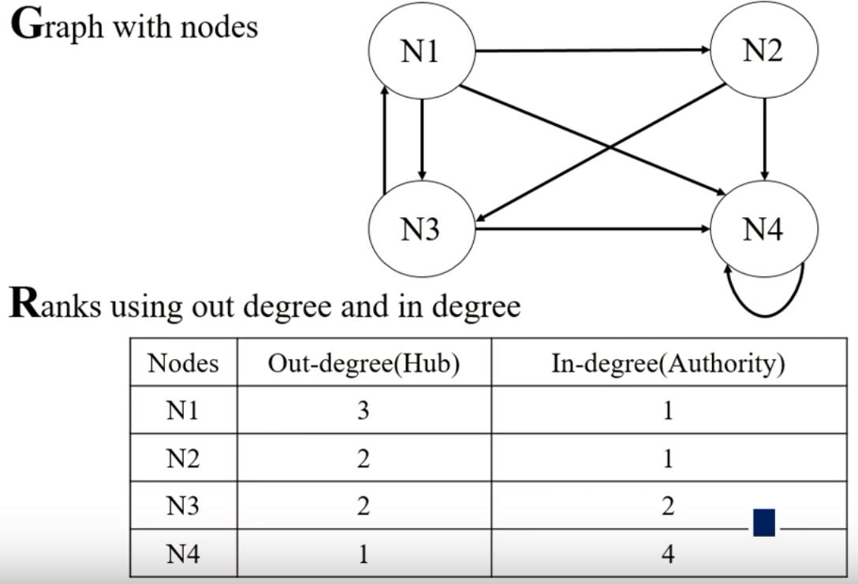
Calculating hub and authorities score
Algorithm:
Start with each node having a hub score
and authority score of 1.
Run the Authority Update Rule
Run the Hub Update Rule
Normalize the values
Repeat from the second step as necessary
Limitation:
assumes that all links pointing to a page
are of equal weight

Slide 7
PageRank Algorithm
Developed by Larry Page and Sergey Brin in 1996.
Method for computing a ranking for every web page based on the graph of web.
PageRank is a numeric value that represents how important a page is on web.
Backlinks and dangling links.
Random surfer model.
Notes:
Rank does not rank website as a whole but it is determined for each page individually.
It is the query independent algorithm that assigns a value to every document independent of query.
To verify its performance, they established the prototype of Google search engine

Slide 8
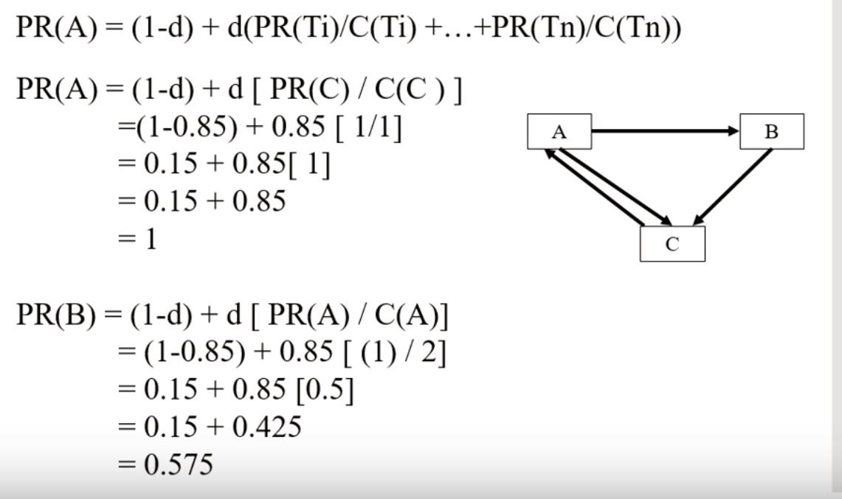
Example
D - damping factor (usually 0.85)
PR(A) - pagerank of page A
PR(Ti) - pagerank of pages Ti
which link to page A
C(Ti) - number of outbound links
on page Ti

Slide 9



Improvements in PageRank Algorithm
Weighted Page Rank

Slide 10
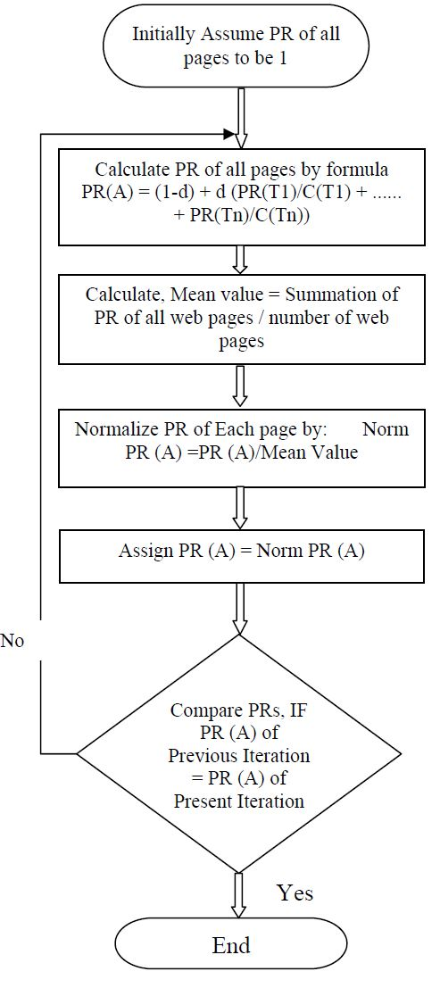
Normalization

Slide 11
Limitations
Topic drift: Since there is no consideration of web content and related topics, it can not recognize whether the search results are relevant to the search topic.
Favors the old pages: Compared to old page, a new page exists a short time, links relation was simple and therefore PR value was small.
Ignore user interest: Based only on the link relationship regardless of user’s interest in a web page.

Slide 12



Improved PageRank Algorithm
Alpha is damping factor, usually taken 0.85. I(v,n) is PR value of page u obtained from page v. Beta v is no. of valid links on the page, nv is total no. of links on the page.
Qv is credibility of the web page u.

Slide 13
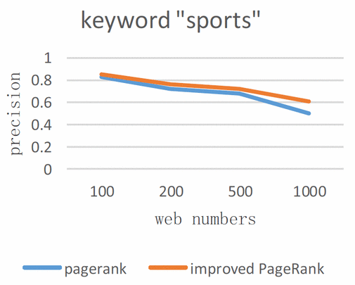
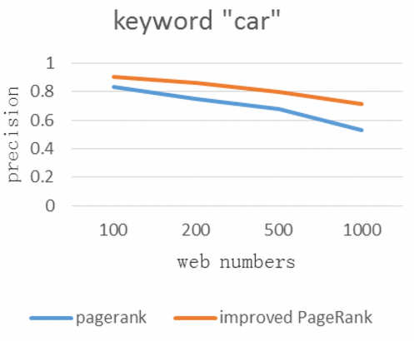
Results

Slide 14
References
LU ZHI XIANG. Research and Improvement of PageRank Sort Algorithm based on Retrieval Results. Nanning university, 530200, China-2014, 7th International Conference
Hema Dubey, Prof. B. N. Roy. An Improved Page Rank Algorithm based on Optimized Normalization Technique. Maulana Azad National Institute of Technology Bhopal, India-2011 International Journal of Computer Science and Information Technologies (2183-2188).
An improved PageRank algorithm based on web content” | Zhou Hao, Pu Quimei, Zhang Hong | 2015
Weighted PageRank algorithm” | Wempu Xing & Ali Ghorbanil | 2004

Slide 15
Queries ????

